Slide 1
CET Reconfigurations & Google SketchUp Interface
Tracy Lanning
CET Designer User Conference
Oct 27, 2011

Slide 2
Reconfiguration Tool - BETA
Replaces Compare
Provides lists of Reuse, Excess and Order
Allows complex comparisons with various sources of products (i.e. Installed base, multiple warehouses)
Can assign Priorities for pulling inventory (i.e. Reusing installed product first before pulling from warehouse.)
Can use both .cmdrw and .sif files for inventories

Slide 3
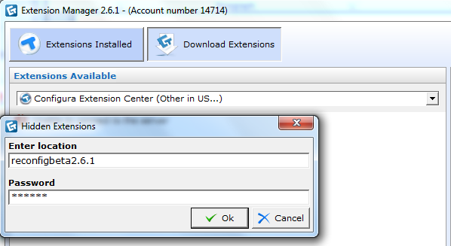
Available now in BETA
Other location (pull-down in Download Extension) location = reconfigbeta2.6.1
Password = fmilpc
Official release in February

Slide 4
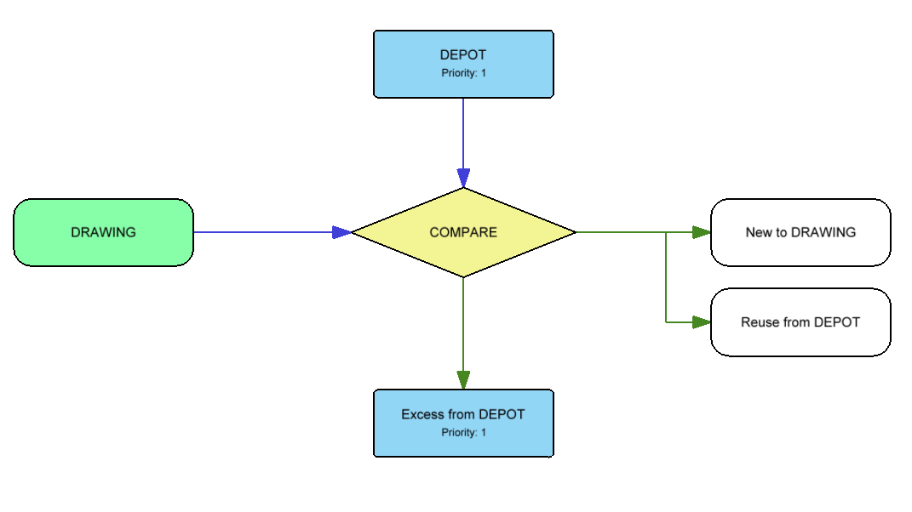
Reconfiguration Tools uses a Graphical Chart to compare various inventory and order lists. Each Box represents a CET drawing file or a .sif file. To select the file, double-click or right-click on the “Drawing” and “Depot” boxes and choose the file.

Slide 5
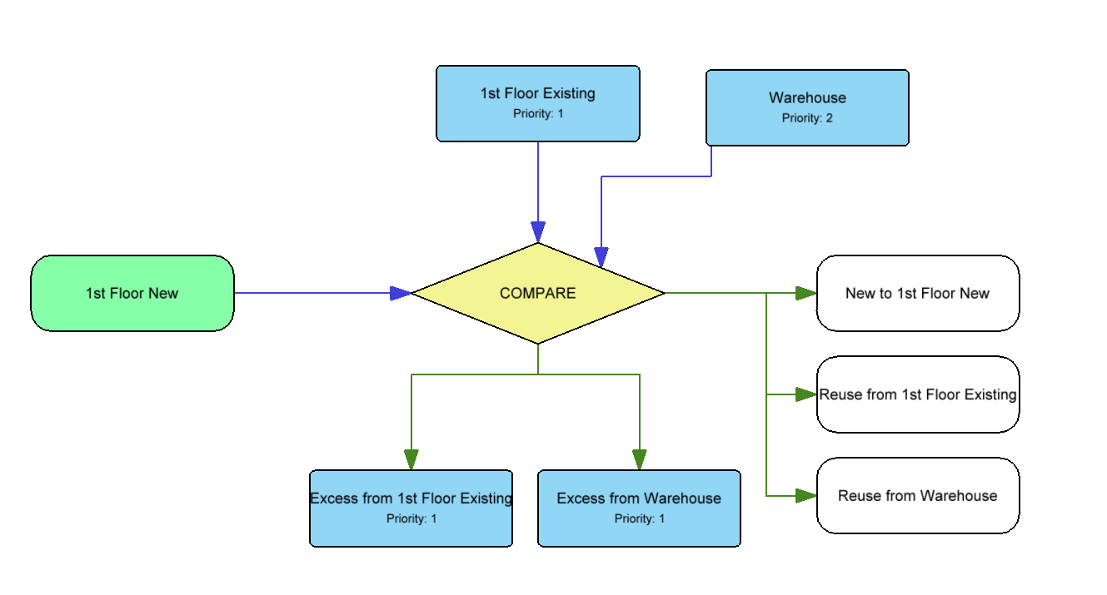
Reconfiguration Tool can pull from Multiple Sources (Depots)

Slide 6
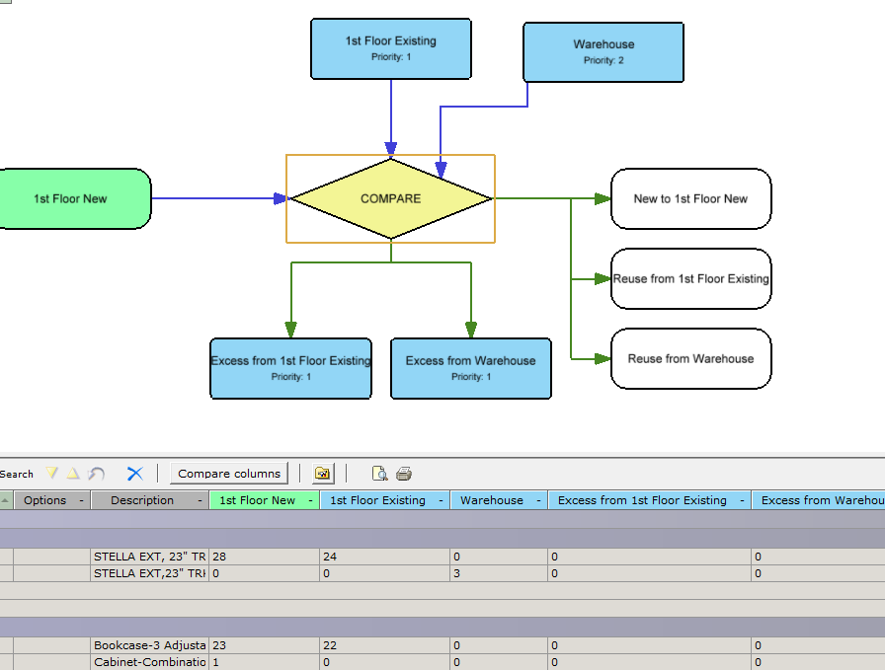
Click on Compare in the center to create the comparison chart. In this view, you will also see the complete spreadsheet of all products with inventories, reuse, excess and order

Slide 7
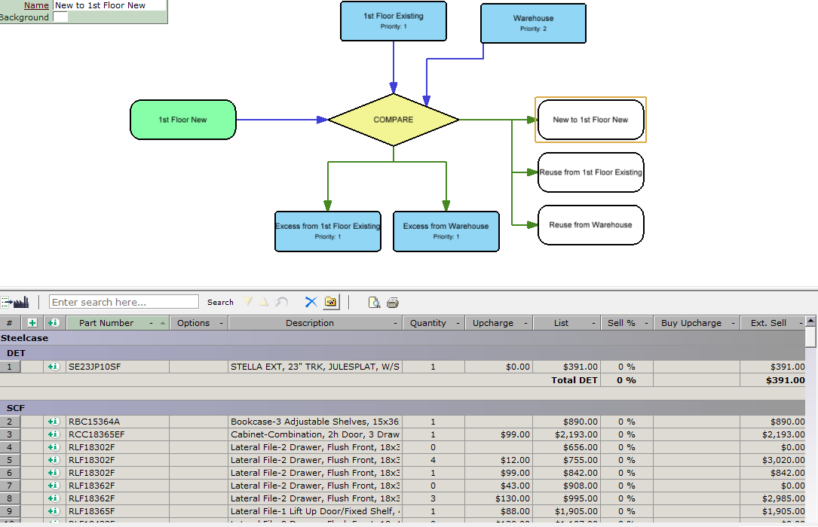
Clicking on any of the output boxes shows the product list associated with that box…New to Buy, Reuse from Installed, Reuse from Warehouse, etc.

Slide 8

Reconfig Currently Allows only One Drawing or SIF file as the “New” Drawing. Current work-around is to merge drawings together to have in the same file or use Picklist to add line items or another SIF file.
Reconfig files are saved as .cmrcf files. They are not saved in the .cmdrw file.

Slide 9
Need BETA testers for Reconfig!
You can have access to the Reconfiguration Tool now (it is in a hidden location), but we ask that you remember it is BETA and give us feedback for improvements.
Interested? Send e-mail to tracy.lanning@configura.com

Slide 10
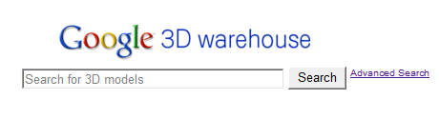
Google SketchUp Interface
Free Extension
Provides direct link into Google 3D Warehouse
Great source for accessory items to complete rendering (people, plants, books, etc)
Great source for generic objects not in your specification (existing furnitire,

Slide 11
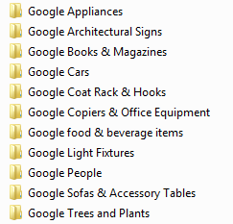
Suggestion: create libraries with Favorites of your best SketchUp items

Slide 12
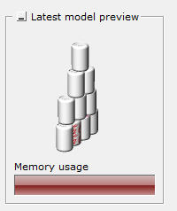
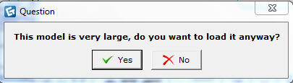
Caution: Beware of Large Images! If you get this warning, this item has a polygon count of 20,000 triangles or higher. (A basic panel has 200 polygons.) These will slow your drawing down.

Slide 13
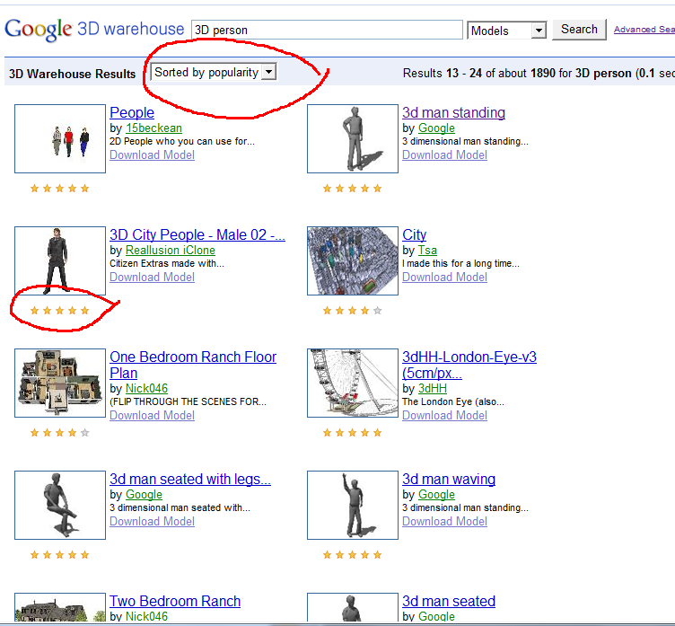
How to find good models:
Specific search (i.e. 3D person instead of person)
Check out the Star ratings

Slide 14
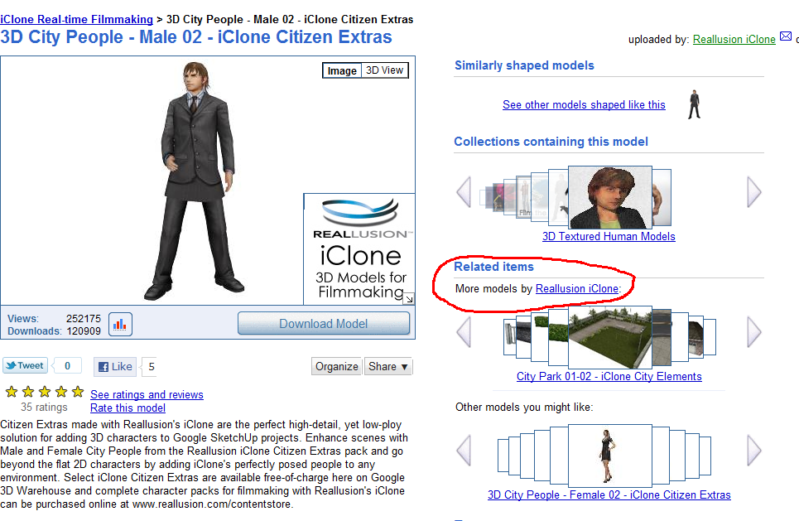
If you find a good model-maker, use the More Models by link.

Slide 15
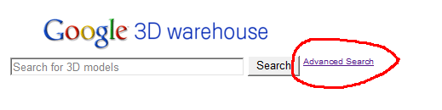
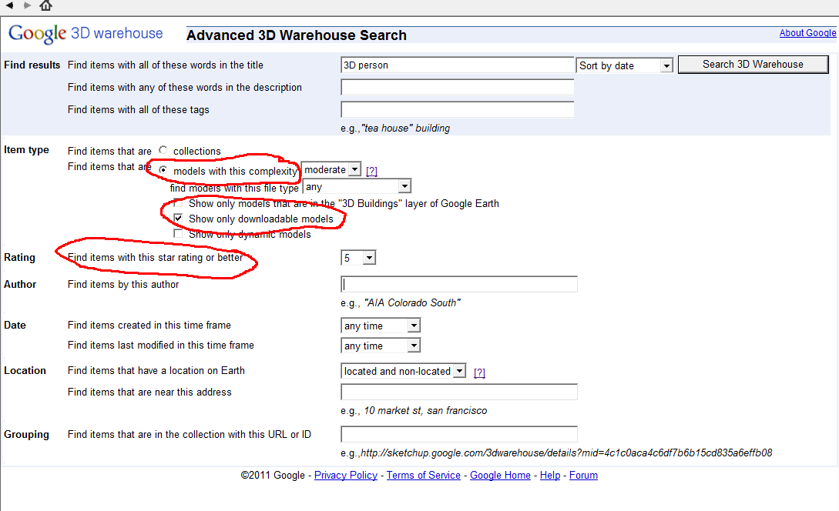
Use Advanced Search

Slide 16
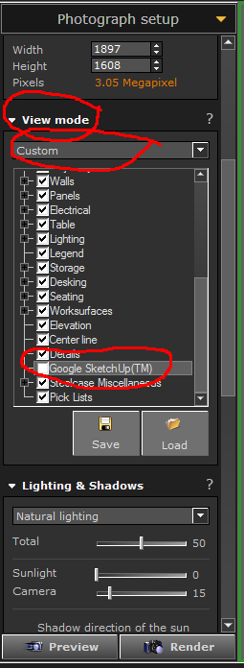

Use Custom View Mode in Photo Lab to not include Google objects in a certain rendering or User-Defined Views

Slide 17
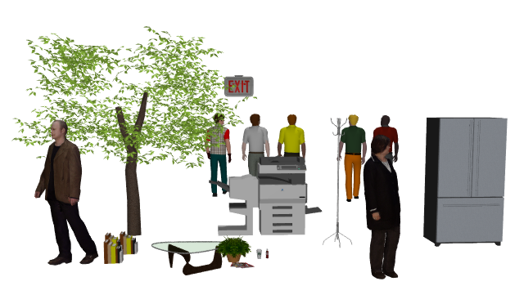


Slide 22
Word

Slide 23
Headline
Word

Slide 24
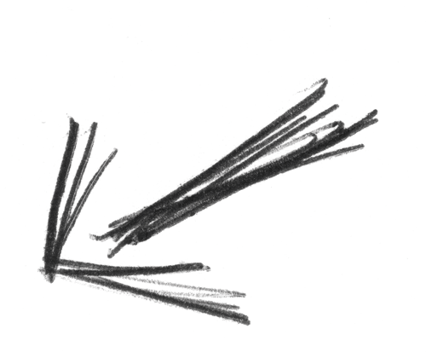
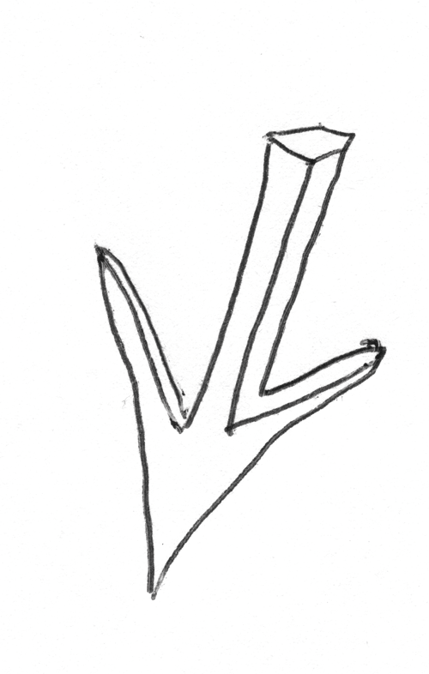
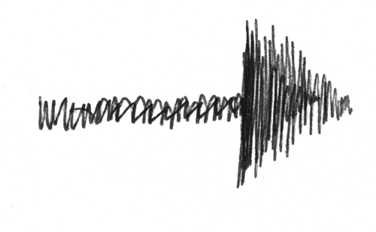
Arrows. Copy and paste. Rotate.

Slide 25
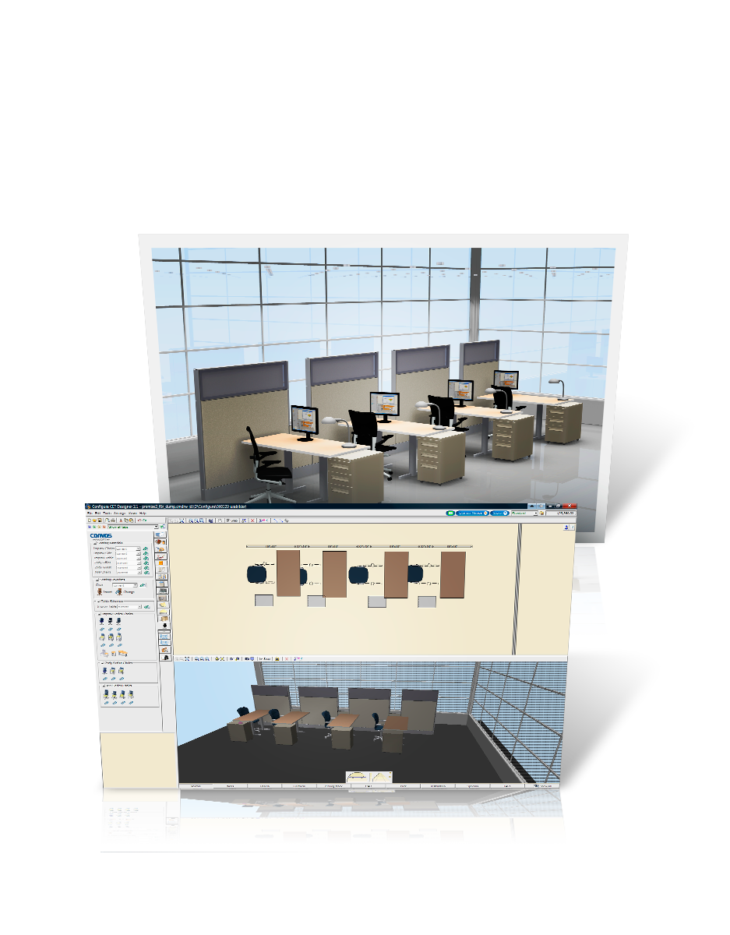
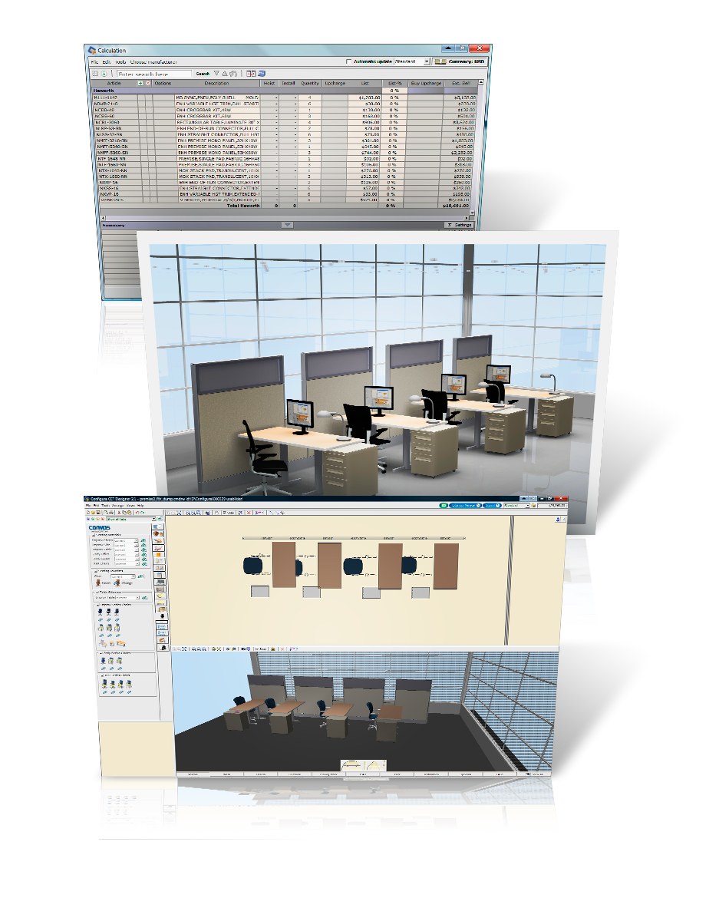
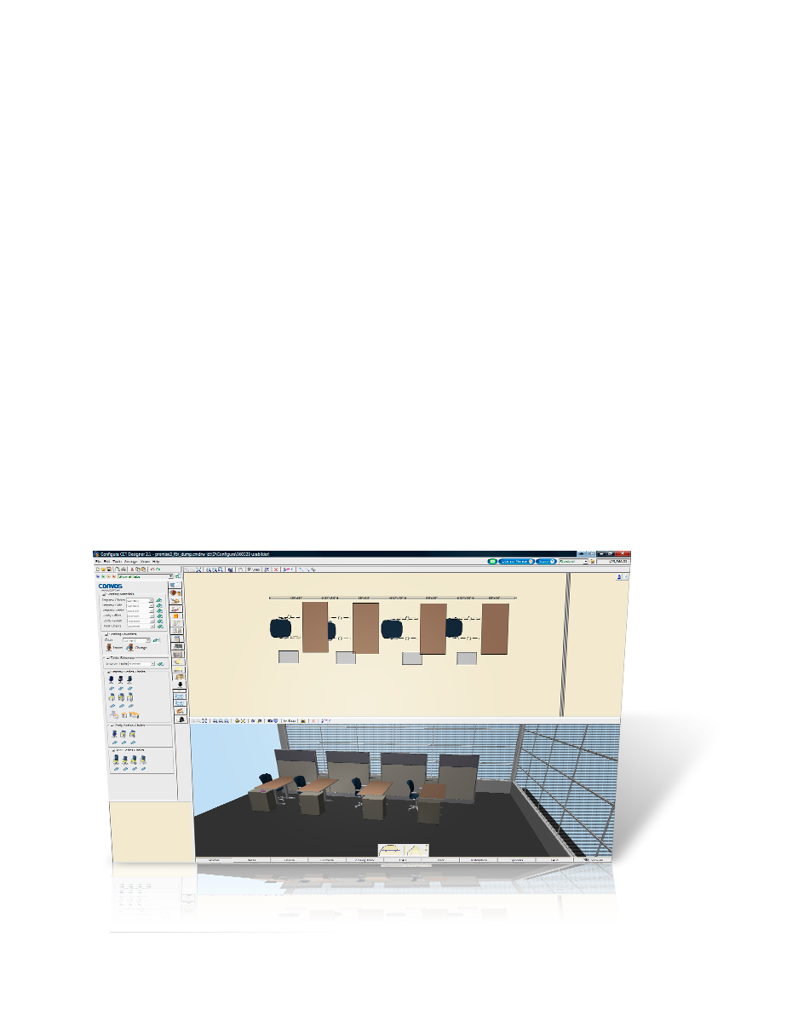

Slide 27
With our users we collaborate to create the solution they want.

Slide 29
With our users, we collaborate to
create the solution that they want,
need and can truly call their own.

